Slide 1
PROJECT TITLE
CAPSTONE PROJECT
Presented By
Student Name : Kamineni Dharmendra Balaji
College Name & Department : Artificial Intelligence & Data Science

Slide 2
OUTLINE
Problem Statement
Technology used
Wow factor
End users
Result
Conclusion
Git-hub Link
Future scope

Slide 3
Problem Statement
Understanding Customer Feedback:Businesses receive vast amounts of unstructured textual data through reviews, social media, and surveys. Identifying the sentiments behind these texts manually is time-consuming and prone to errors.Automating Sentiment Detection:Traditional sentiment classification methods struggle to effectively process nuanced expressions such as sarcasm, idioms, and slang, which often lead to misinterpretation.

Slide 4
Technology used
LibrariesPython Libraries:NLTK (Natural Language Toolkit): For tokenization, lemmatization, and sentiment classification.TextBlob: Simplified text processing, including sentiment analysis.VADER (Valence Aware Dictionary for Sentiment Reasoning): Specialized for social media sentiment analysis.spaCy: Advanced NLP with support for deep learning models.Scikit-learn: For building custom machine learning models for sentiment classification.Hugging Face Transformers: Pre-trained transformer models like BERT, RoBERTa for high-accuracy sentiment classification.

Slide 5
Wow factors
1. Real-Time Analysis and VisualizationUnique Feature: Perform real-time sentiment analysis on live data streams (e.g., Twitter API, news updates).Wow Factor: Display results on an interactive dashboard with dynamic charts and heatmaps to visualize sentiments geographically or over time.2. Multilingual SupportUnique Feature: Develop a sentiment analysis model capable of understanding and analyzing multiple languages or regional dialects.Wow Factor: Address a global audience by breaking language barriers, especially using NLP techniques like translation models or multilingual embeddings (e.g., BERT or XLM-R).

Slide 6
End users
1. Businesses and CorporationsMarketing Teams: To analyze customer feedback and optimize campaigns based on sentiment trends.Customer Support: To assess the tone of customer interactions and prioritize or automate responses.Product Teams: To gather insights from reviews or complaints for product improvements.2. Media and Content CreatorsSocial Media Managers: To monitor public sentiment about brands, events, or campaigns.Content Strategists: To tailor content based on audience reactions and preferences.Influencers: To gauge audience sentiment about specific posts, collaborations, or topics.

Slide 7
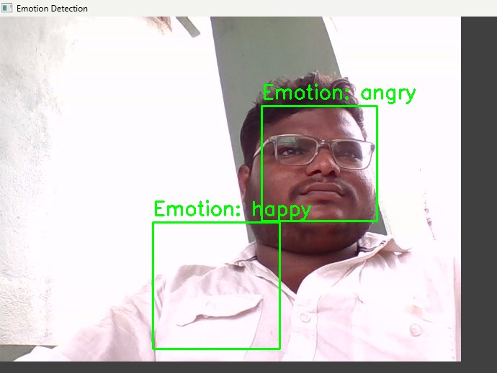
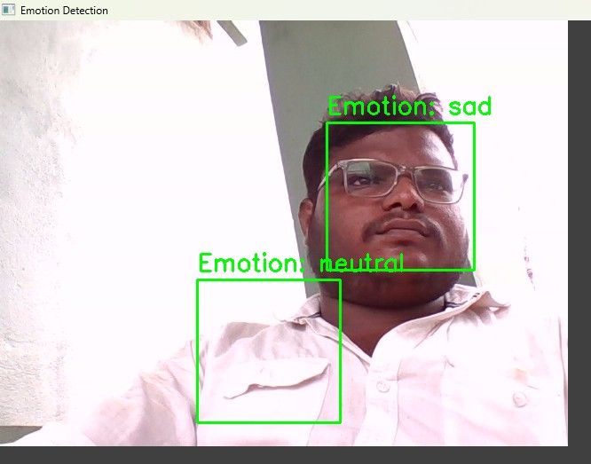
Results

Slide 8
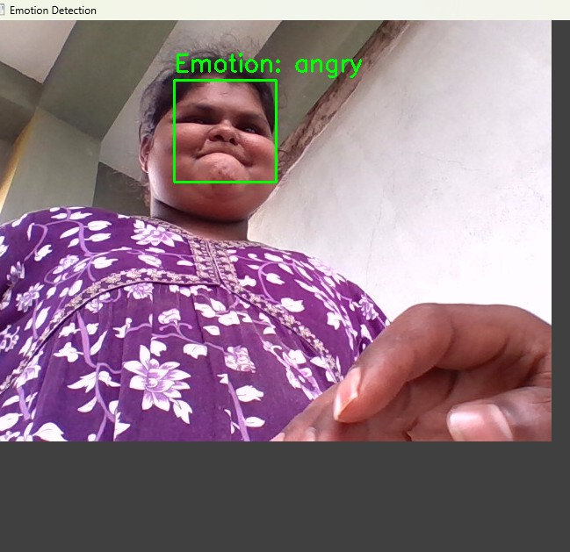
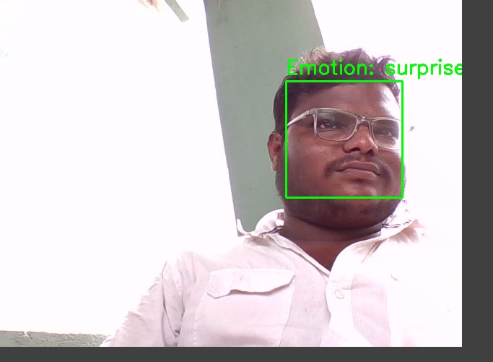
Results

Slide 9
Conclusion
In today's data-driven world, understanding public opinion and sentiment has become crucial for decision-making across industries. Our sentiment analysis project addresses the growing need to process and interpret vast amounts of unstructured textual data from sources such as social media, customer reviews, and news articles. By leveraging advanced Natural Language Processing (NLP) techniques, we have successfully developed a solution that identifies, analyzes, and classifies sentiments with precision.Through the project, we demonstrated the capability to:Analyze Sentiments: Provide real-time insights into public sentiment trends.Enhance Decision-Making: Empower businesses, policymakers, and other stakeholders with actionable insights.Foster Innovation: Develop context-aware, scalable, and multilingual sentiment analysis tools that stand out in their field.Our solution not only bridges the gap between raw textual data and meaningful insights but also opens new avenues for predictive analytics, personalized recommendations, and social impact. Ultimately, this project showcases the transformative potential of sentiment analysis in addressing the challenges of understanding emotions and opinions in a fast-paced, digital-first world.

Slide 10
GitHub Link
https://github.com/KDharmendraBalaji/SENTIMENTAL-ANALYSIS-PROJECT-BY-K.D.B.-

Slide 11
THANK YOU

